Slide 1
Pakistan House Price Sales 2023 Analysis
Group 6 :
ChihHao Yuan
Ching Yu Hsu

Slide 2
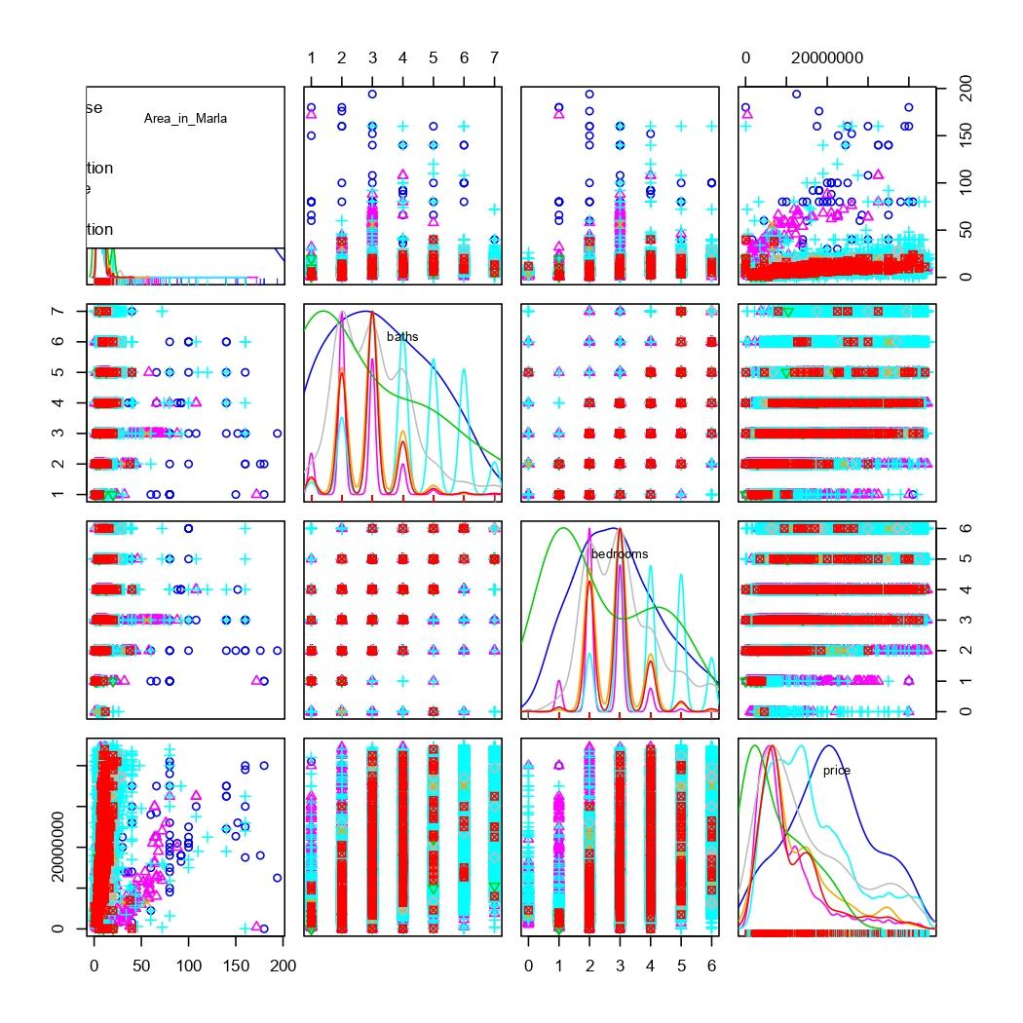
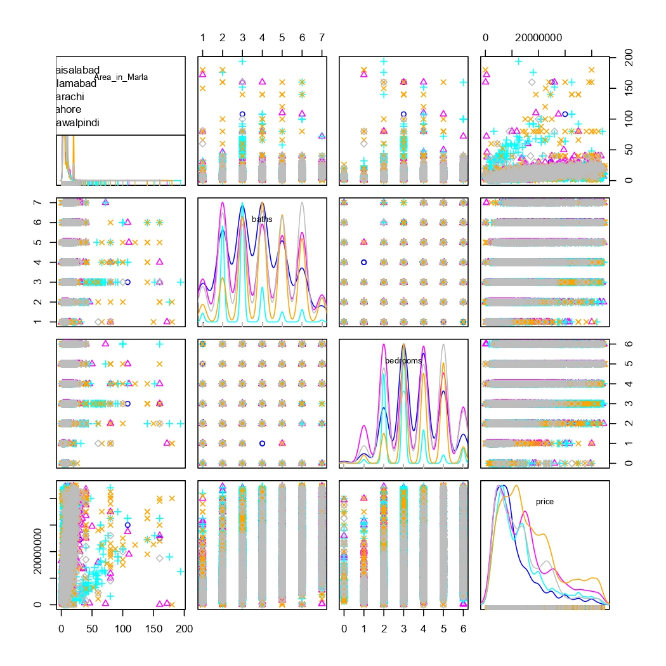
1- Generate charts to display relationships
by property type
by city

Slide 3
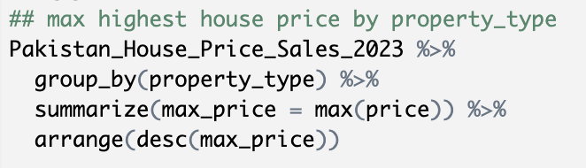
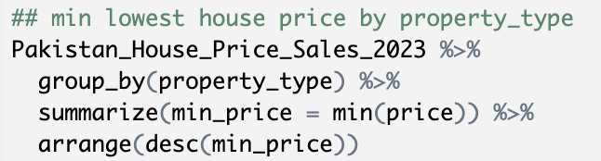
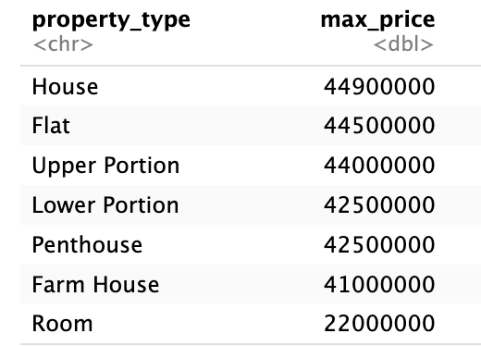
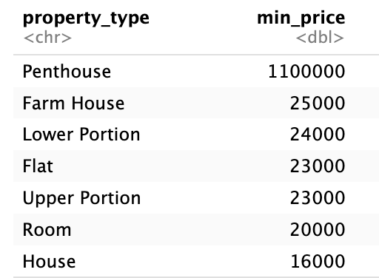
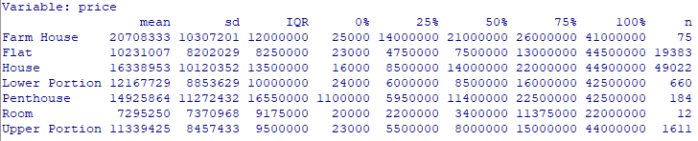
2a)- Descriptive statistics of all quantitative variables by property type

Slide 4
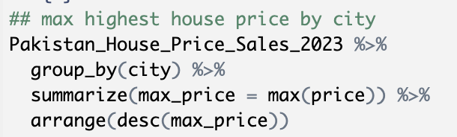
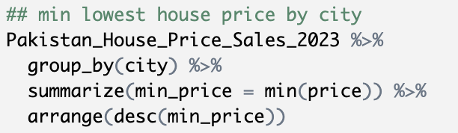
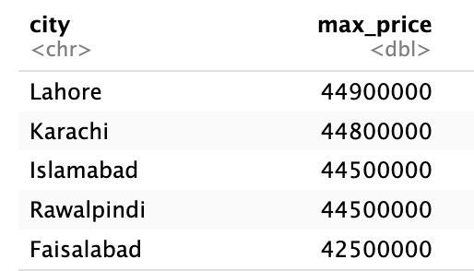
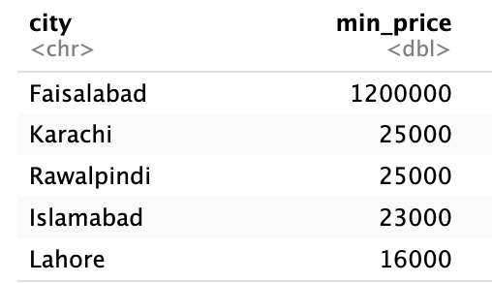
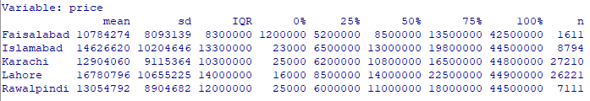
2b)- Descriptive statistics of all quantitative variables by city

Slide 5
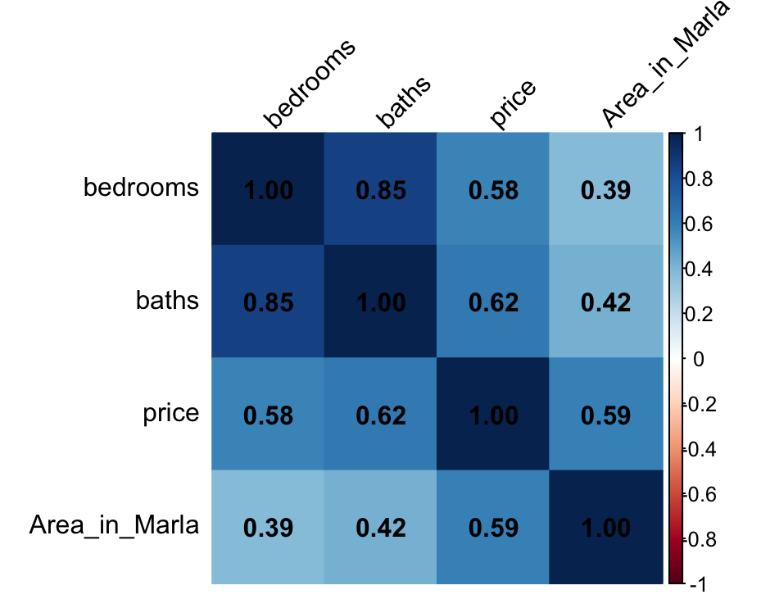
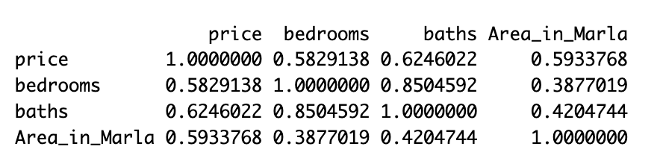
2c)- Correlation matrix of all quantitative variables
The strongest correlation
➜Baths and bedrooms(0.85)

Slide 6
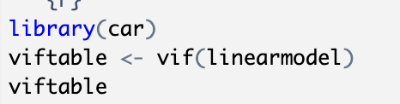
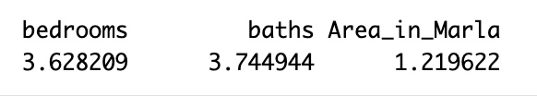
2d)- VIF of all quantitative variables
The VIF of these variables are all below 10, indicating no serious multicollinearity

Slide 7
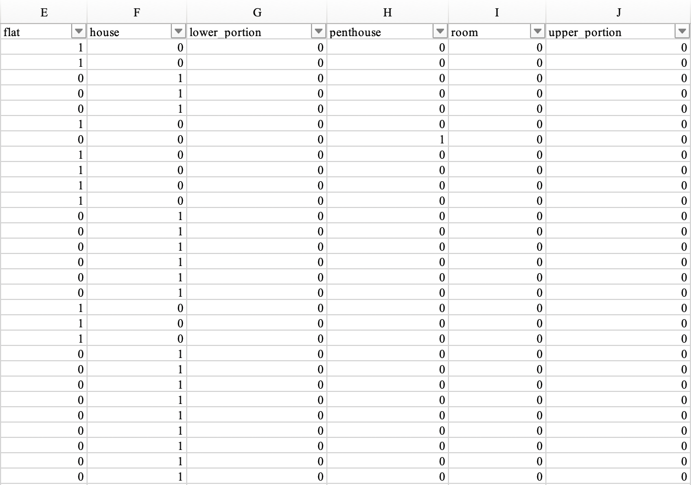
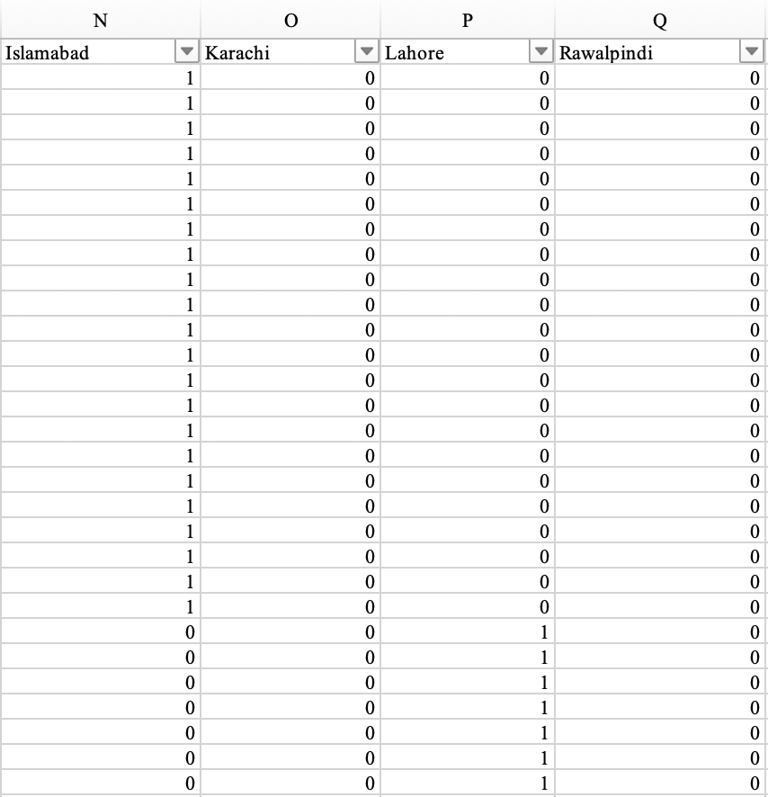
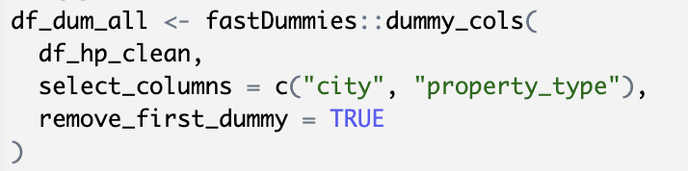
3a)- Convert property type and city to dummy variables

Slide 8
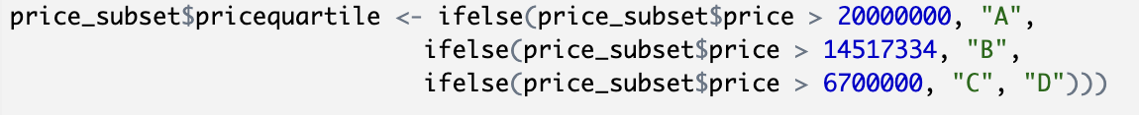
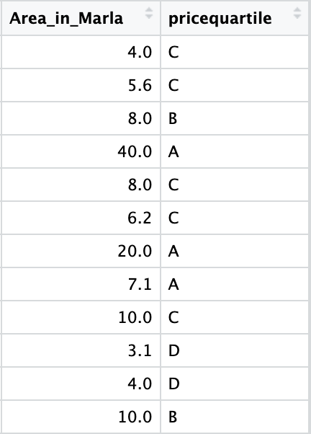
3b)- Create a new Y-variable (pricequartile) A for highest quartile, B for second highest quartile, C for third highest quartile, D for lowest quartile of price

Slide 9
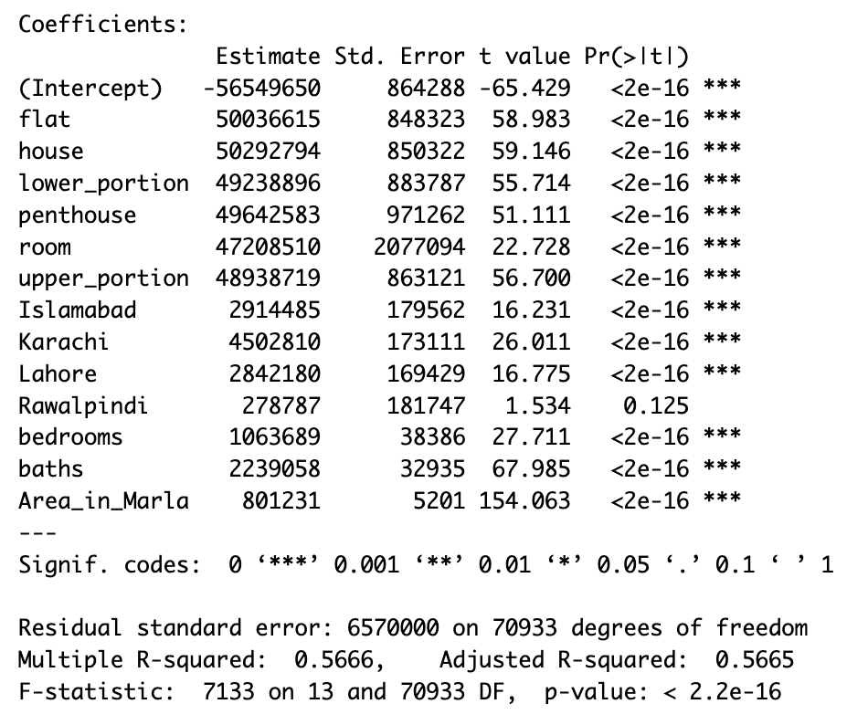
3c)- Run a linear regression for price as the Y-variable against property type, city, bedrooms, bathrooms, area as the X-variables.
If there is a house located in Lahore, with
3 bedrooms and 2 baths and a size of 10 Marla
The predict price is
- 56549650
+50292794+2842180+3*1063689+2*2239058+10*801231
= $12,266,817
 | Predict price
flat | Intercept (farm house) +50036615
house | Intercept (farm house) +50292794
room | Intercept (farm house) +47208510
Islamabad | Intercept (Faisalabad) +2914485
Karachi | Intercept (Faisalabad) +4502810
Lahore | Intercept (Faisalabad) +2842180

Slide 10
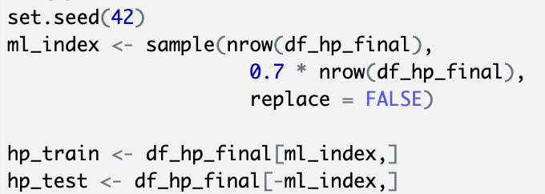
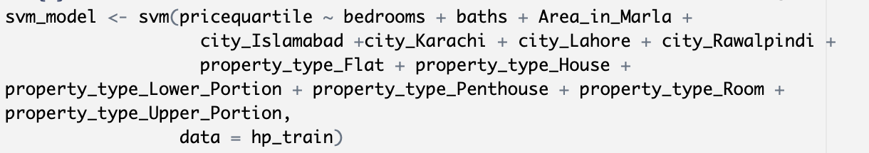
3d)- Run a SVM for pricequartile as the Y-variable against property type, city, bedrooms, bathrooms area as the X-variables.
Set the training and testing data
Run the SVM model
Predict

Slide 11
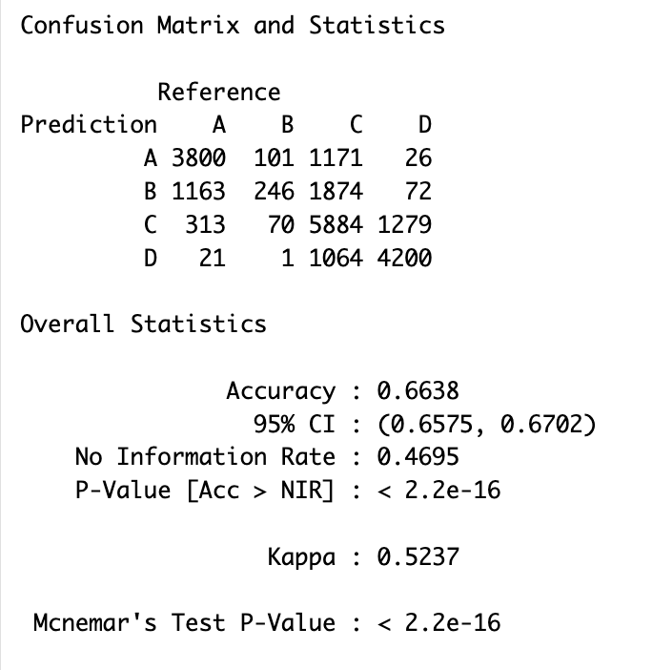
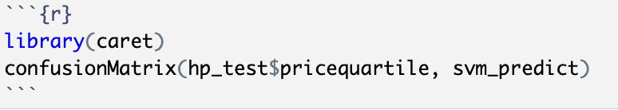
SVM Model and Accuracy
Accuracy : 0.6638

Slide 12
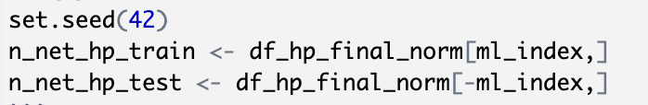
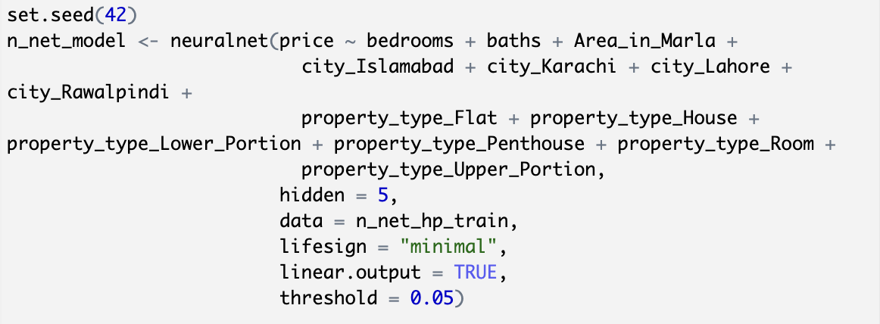
3e)- Run a neural network with 5 hidden nodes for price as the Y-variable against property type, city, bedrooms, bathrooms, area as the X-variables.
Function definition
Split the dataset to training and testing
Run the neural network model

Slide 13
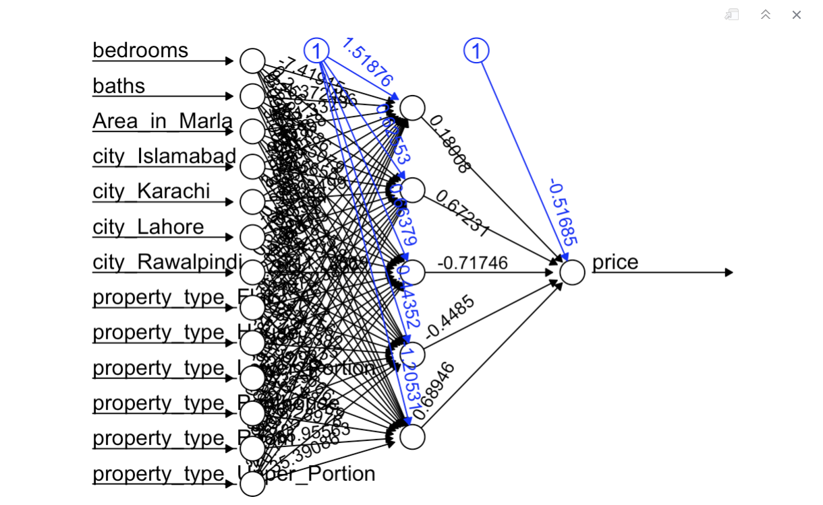
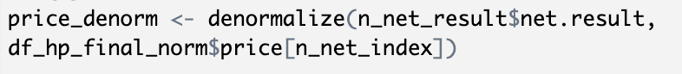
Neural Network Model and Correlation
Correlation :0.84

Slide 14
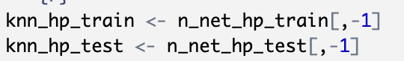
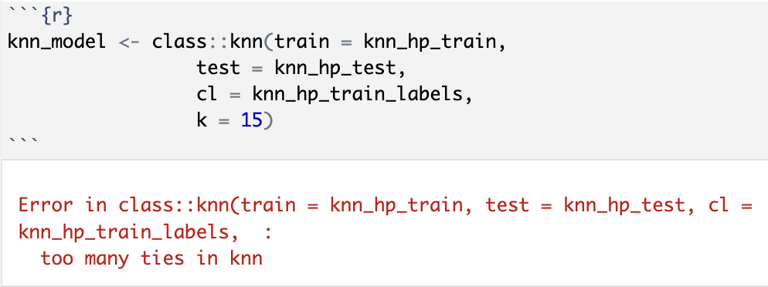
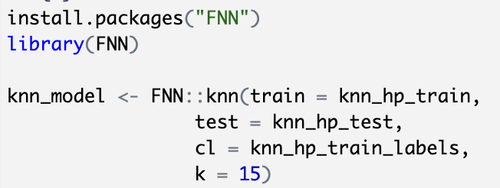
3f)- Run a K-nearest neighbor analysis on pricequartile as the Y-variable against property type, city, bedrooms, bathrooms, area as the X-variables.
Remove the price column
Error!!!!!
Use “FNN” to fix the problem of “tie”
Notes:
if multiple test observations encounter a tie — meaning the nearest neighbors have equal votes among different classes — the model cannot determine a predicted class, resulting in the error message: "too many ties in knn".
This occurs because class::knn() does not include a built-in tie-breaking mechanism, and therefore cannot automatically resolve tie situations during classification.
`FNN::knn()` function automatically handles tie situations.
Even when k is even and multiple classes have equal votes, FNN::knn uses internal tie-breaking logic
— such as selecting the class of the nearest neighbor — and does not produce an error.

Slide 15
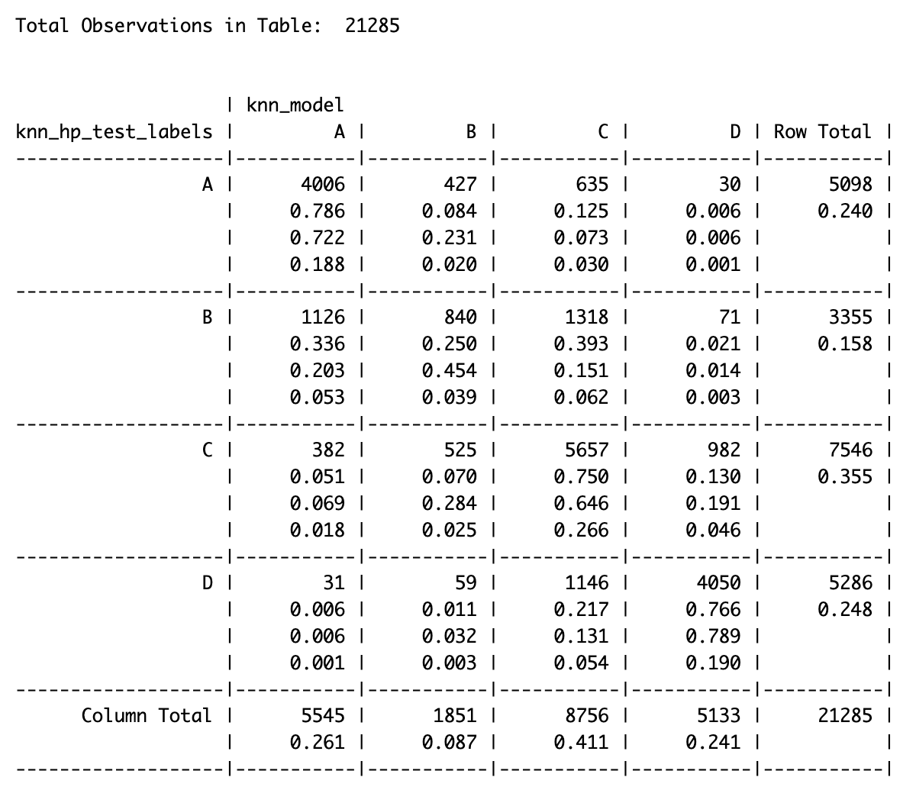
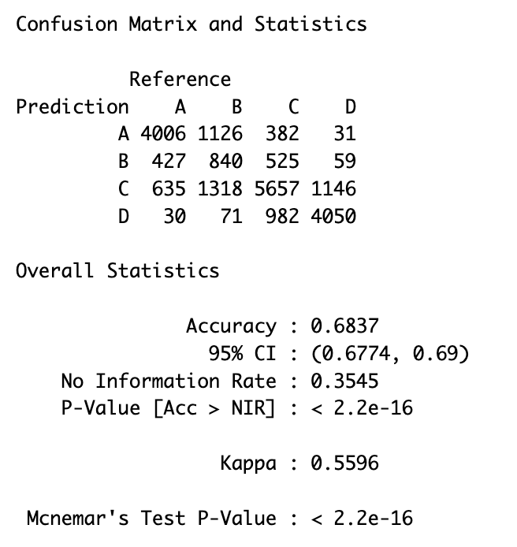
K-nearest neighbor Model and Accuracy
Accuracy : 0.6837

Slide 16
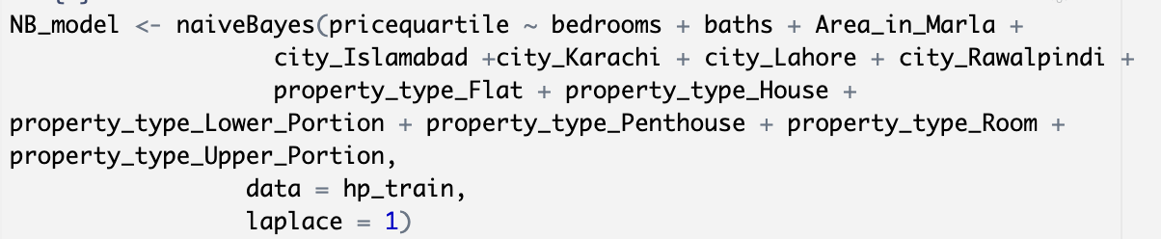
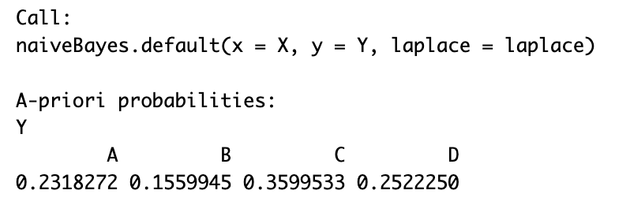
3g)- Run a Naïve Bayes analysis on pricequartile as the Y-variable against property type, city, bedrooms, bathrooms, area as the X variables
Run Naïve Bayes model

Slide 17
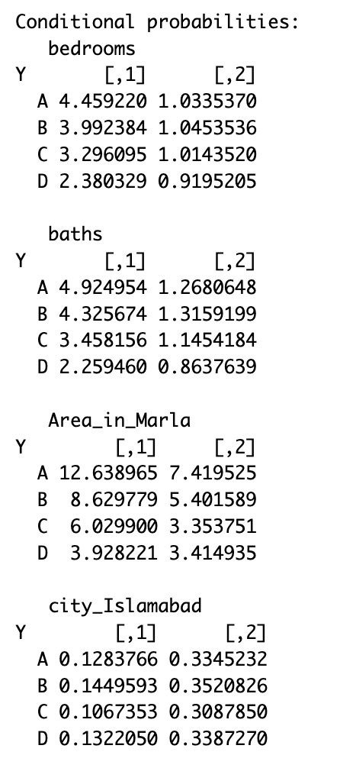
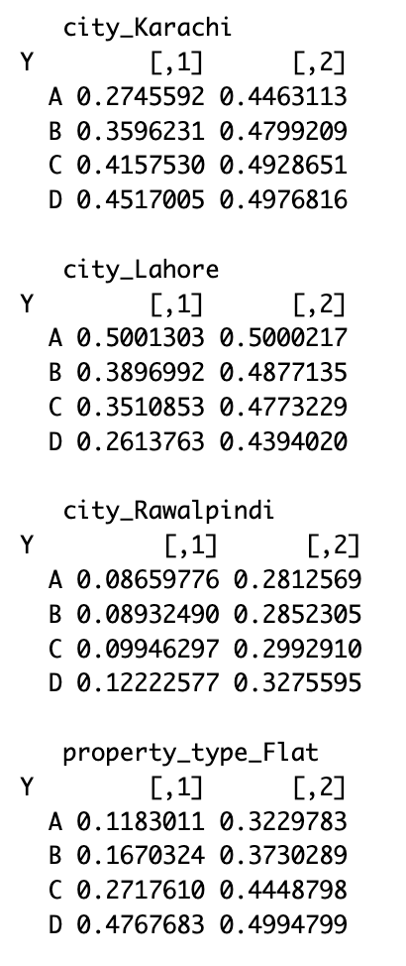
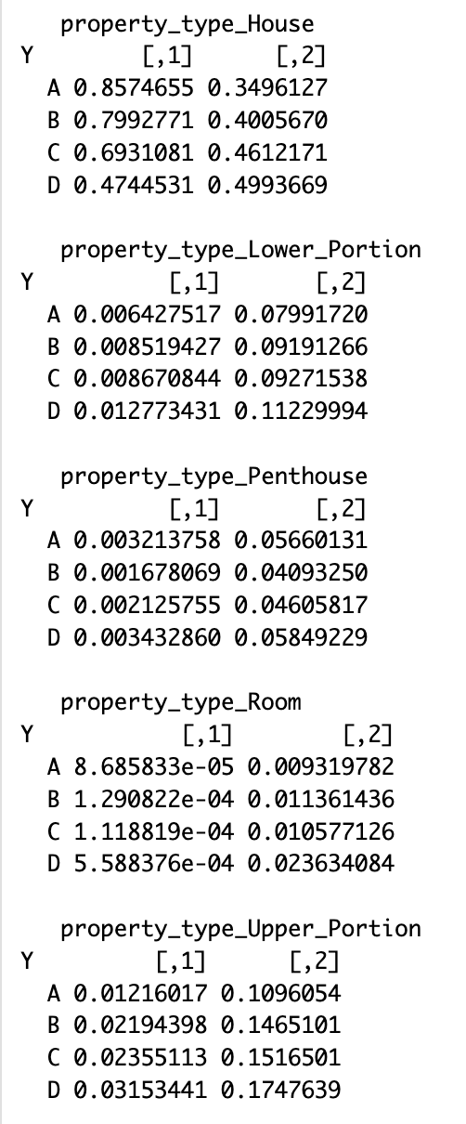
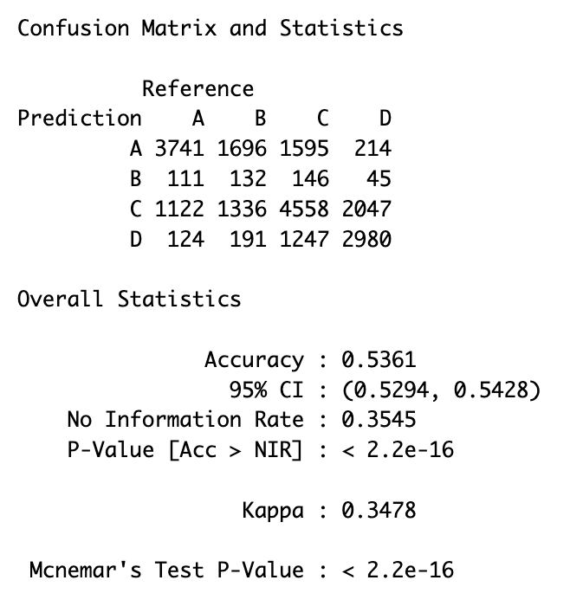
Naïve Bayes Model and Accuracy
Accuracy : 0. 5361

Slide 18
3h)- Summarize the accuracy of all models
Model | Accuracy/Correlation | P-value
SVM | 0.6638 | 2.2e-16
Neural Network | 0.84 (correlation)
K-nearest neighbor | 0.6837 | 2.2e-16
Naïve Bayes | 0.5361 | 2.2e-16

Slide 19
4)- List of Lessons Learned
a. Which technique worked best (accuracy)?
It’s not ideal to compare all models directly, because Neural Network is evaluated by correlation, but others are evaluated by accuracy.
This neural network has a strong predictive (correlation = 0.84)
If we just consider the accuracy, K-nearest neighbor works best (accuracy=0.6837)

Slide 20
4)- List of Lessons Learned
b. What insights do you have on which variables influence housing prices in Pakistan?
Based on the linear regression, we found the p-value of property type, city, bedrooms, bathrooms, area are statistically significant.
So, we can conclude these 5 variables will impact house prices in Pakistan.
Property type
city
bedrooms
bathrooms
area

Slide 21
Thanks!
Pakistan House Price Sales 2023 Analysis
Group 6:
Chih Hao Yuan, Ching Yu Hsu

